Slide 1
Terrestrial ECVs
Fire/burnt area, Land cover, Soil Moisture

Slide 2
Product summaries
Pixel product: monthly, MERIS resolution, date of detection, 2006-2008
Grid product: 15 day, 0.5x0.5°, 2006-2008
Validation based error matrices, using LandSat
Probabilistic description of uncertainty
Improvements wrt StoA (e.g GFED): higher spatial reolution, better balanced accuracies
Model assimilation: emissions through ORCHIDEE
Improvements for phase 2: longer time series (2000-2017): full MERIS record, MODIS, OLCI; fire database for Africa (landsat-8, Sentinel-2, Sentinel-1

Slide 3
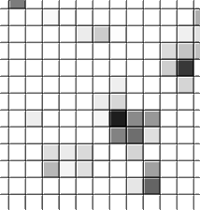
Product summaries
BA:
Pixel product: monthly, MERIS resolution, date of detection, 2006-2008
Grid product: 15 day, 0.5x0.5°, 2006-2008
LC:
3 epochs centred around 2000, 2005, 2010
Including land surface condition climatology: NDVI, Burnt area, snow cover
Water bodies mask based on ASAR
MERIS surface reflectance
SM:
2 versions released, 3rd version in internal reviw (release Dec 2015)
3 products: active, passive, combined, based on 9 MW sensors
1978-2014

Slide 4
Error characterisation
Innovative ways for QA are being explored:
BA: Probabilistic description of uncertainty
LC: 19 experts each dealing with ~200 points, cross-walking uncertainty
SM: signal-to-noise ratio as error metric

Slide 5
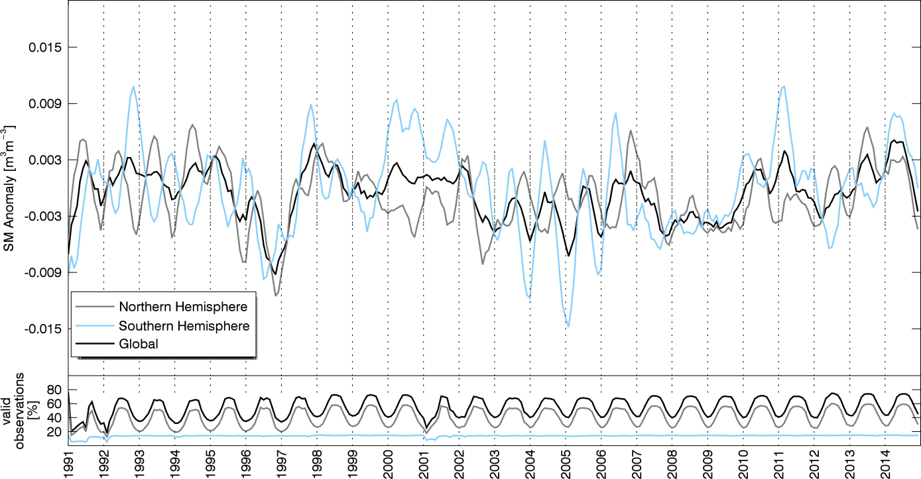
C3S, H2020 + outreach
C3S: No one really knows, but everyone is giving best effort to get prepared
FP7/H2020: used in various FP7 projects and various H2020 proposals submitted for all ECVs
Several national projects and initiatives
International and national activities:
BA: GOFC-GOLD; USGS ECV
LC: GOFC-GOLD
SM: GEWEX GDAP, BAMS StoCl
[Dorigo et al., 2015, BAMS State of the climate in 2014]

Slide 6
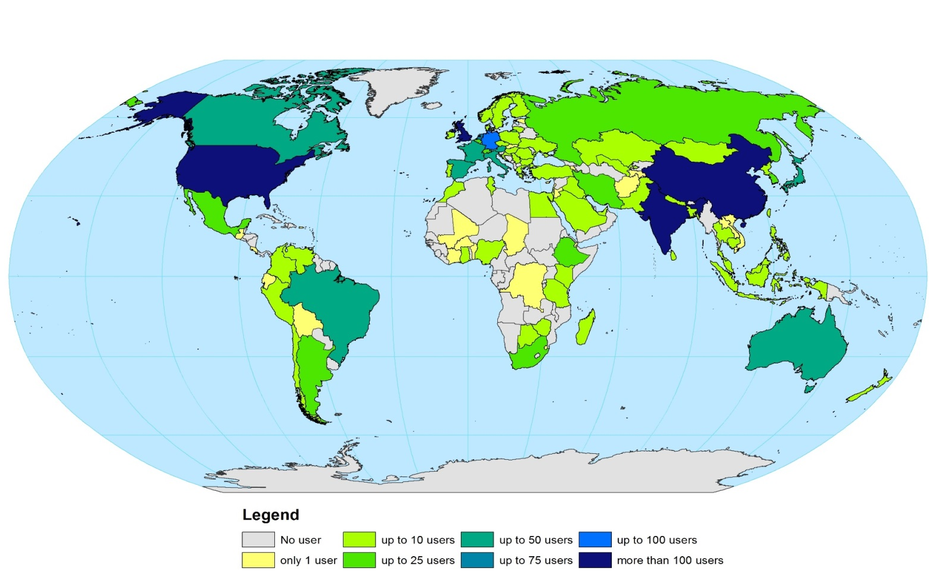
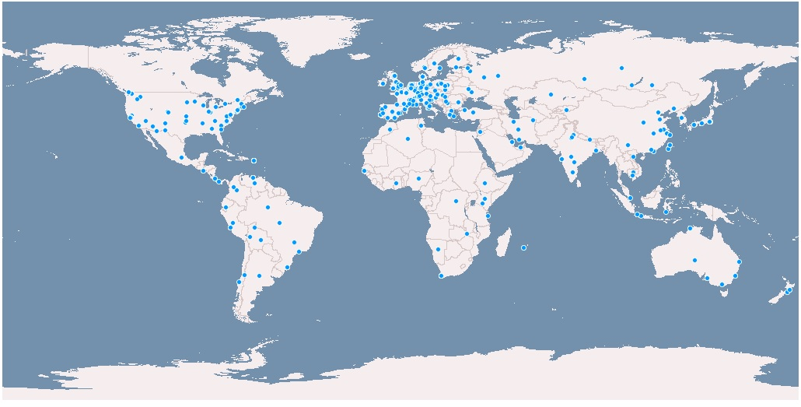
User statistics
Many users of LC (750) and SM (1700) but also large potential for BA (>300 of GFED)

Slide 7
Planned activities phase 2
Various product updates
BA (2): longer time series (2000-2017): full MERIS record, MODIS, OLCI; fire database for Africa (landsat-8, Sentinel-2, Sentinel-1
LC: Epoch 2015, based on PROBA-V & Sentinel-3
Epoch 1992-93, based on AVHRR used for IGBP DISCover
Change product back to 1982, based on AVHRR GIMMS
Seasonal water bodies product
Sentinel-2 over Africa
SM: 3 updates
Yearly extensions
Integration of new sensors: SMOS, MEtOp-B, FengYun
dataset

Slide 8
Cross-ECV activities
BA: Fire risk assessment with SM and LST
BA: Fire emissions: GHG,Ozone, aerosol
BA: deforestation fires: LC
BA : LC maps included in gridded BA layers
LC: include soil moisture climatology ?
LC : BA to be averaged as land surface seasonality component
SM: fire risk ?

Slide 9
Common issues
Common input datasets -> strive for consistency
MERIS: BA and LC sharing most of the processing chain
Sentinel 1: BA, LC, SM
Sentinel 2: BA, LC
Common water mask (LC)
Need to establish cloud platforms that enable cooperation:

