Slide 1
SATELLITE-BASED DROUGHT INDICATORS AND INDICES
Suhyb Salama, University of Twente

Slide 2
Learning outcomes
After completing the lecture and associate exercises you should be able to:
Differentiate between indices and indicators
Validate satellite products of climate indicators of essential climate variables
Convert satellite indicators of essential climate variables to indices
Monitor and detect metrological and agricultural drought indices

Slide 3
Indicators vs Indices
Indicators are variables or parameters used to describe drought conditions. Examples include precipitation, temperature, streamflow, groundwater and reservoir levels, soil moisture and
snowpack.
Indices are typically computed numerical representations of drought severity, assessed using climatic or hydrometeorological inputs including the indicators listed above. Indices are, thus, technically indicators as well but can simplify complex relationships and provide quantitative assessment of the severity, location, timing and duration of drought.
Indices
Indicators
Data
Increasing data concentration
After Braat, in Kuik and Verhruggen 1991

Slide 4
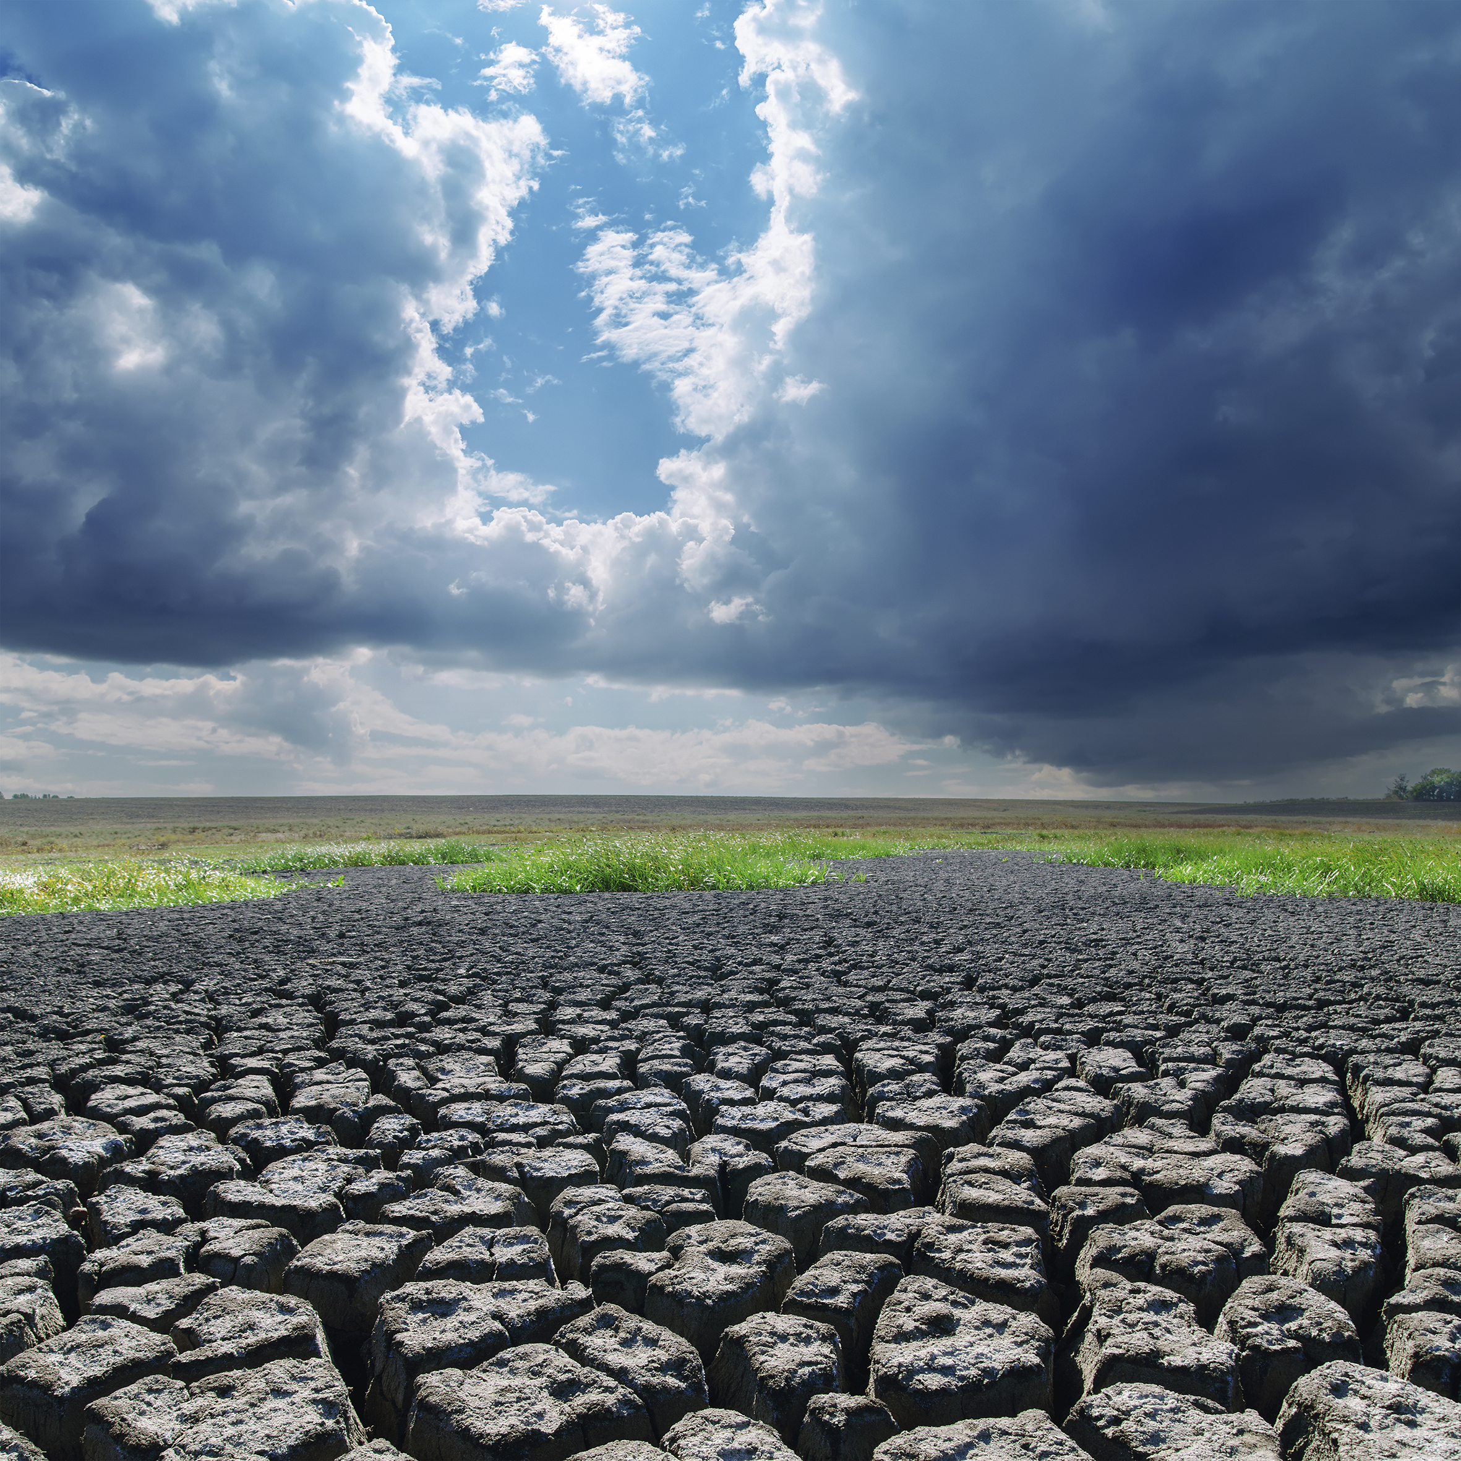
Characteristics of a drought event
Severity refers to the departure from normal of an index. A threshold for severity may be set to determine when a drought has begun, when it ends and the geographic area affected.
Timing and duration are determined by the approximate dates of onset and cessation.
Impact A short, relatively low severity, intra-season drought, if it occurs during the moisture sensitive period of a stable crop, can have a more devastating impact on crop yield than a longer, more severe drought occurring at a less critical time during the agricultural cycle.
Thus, drought indices – in combination with additional information on exposed assets and their vulnerability characteristics – are essential for tracking and anticipating drought-related impacts and outcomes.

Slide 5
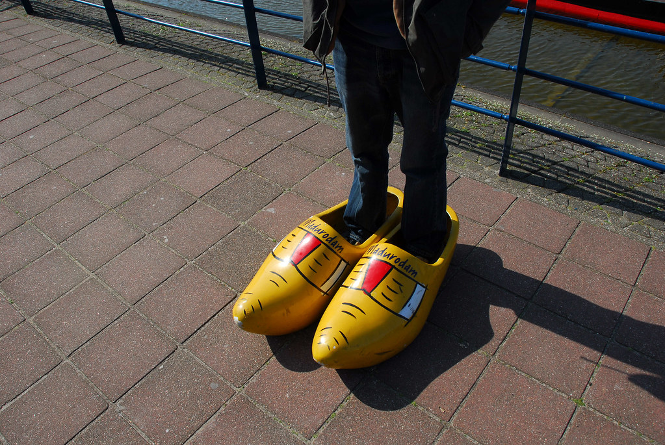
No one-size-fits-all
There is no single indicator or index that can account for and be applied to all types of droughts, climate regimes and sectors affected by droughts.
Many factors feed in to determine which indicator or index is the best to use for a particular need or application:
Timely detection
Sensitive to drought, severity, onset and termination?
Reflective of the impacts occurring on the ground
Consistency
Spatial & temporal representativeness
Feasibility to calculate and establish long-term data record
Cees Wouda, Licensed with CC BY-NC-ND 2.0.

Slide 6
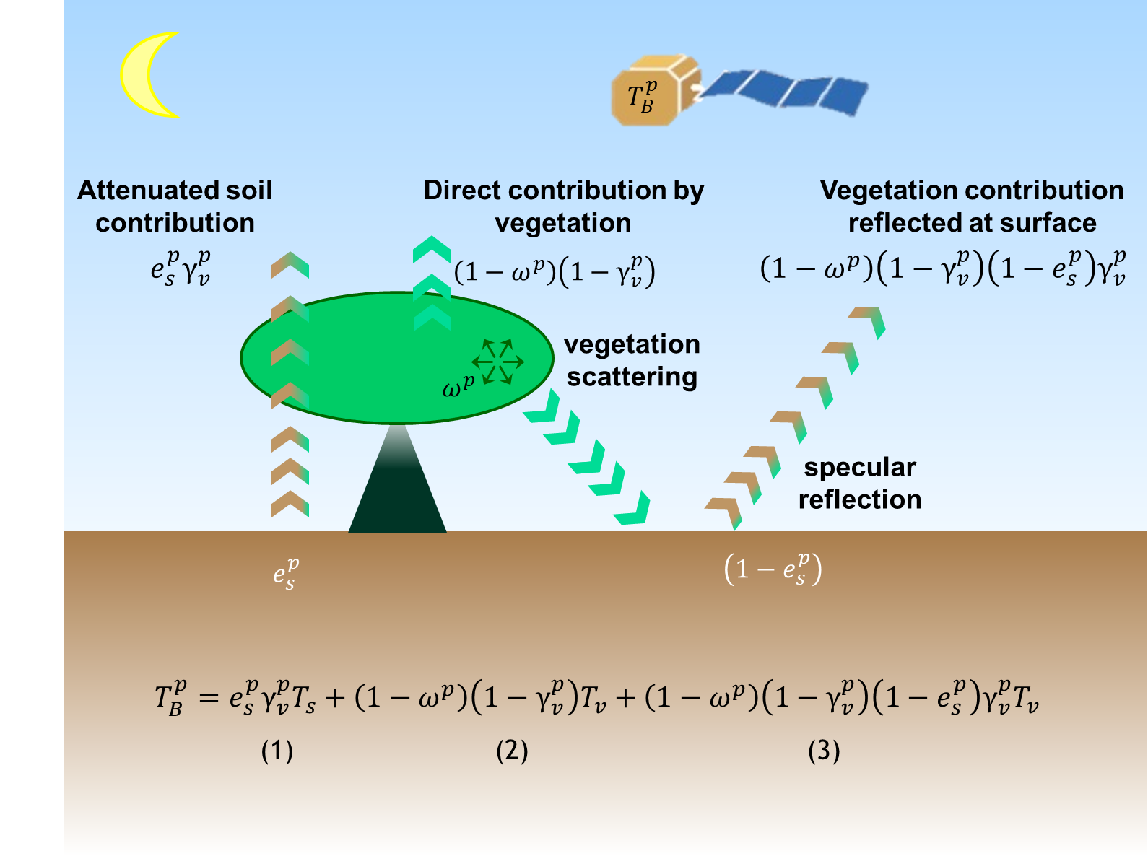
How trustworthy satellite-based indicators are?
The action to check the accuracy (quantifying the uncertainty) of “hydrological” variables as derived form satellite is called validation.
For example, satellite derived soil moisture values are compared against in-situ measurements.
The results of this comparison is expressed by uncertainty.
Small values of uncertainty indicate high accuracy (the indicator is trustworthy) and large values indicate low accuracy.
Tau Omega model, Mo et al. (1982)
Sketched by R. van der Velde, ITC, University of Twente, the Netherlands

Slide 7
Error vs uncertainty
Error is the difference between observation and the true value. It measures how close a measured value is to the true value (accuracy). As true values are by nature indeterminate (GUM: B.2.3, note 2), error cannot be determined and discussed meaningfully.
Uncertainty of a measured value is an interval around that value such that any repetition of the measurement will produce a new result that lies within this interval.
Precision measures how closely two or more measurements agree with other.
Error (unknown) leads to uncertainty (can be quantified)

Slide 8
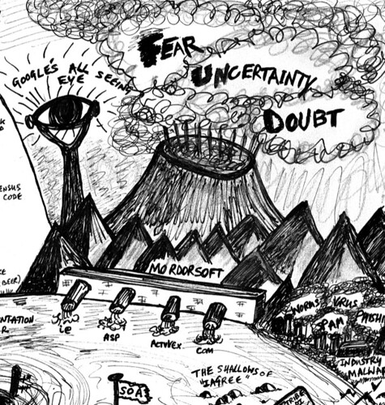
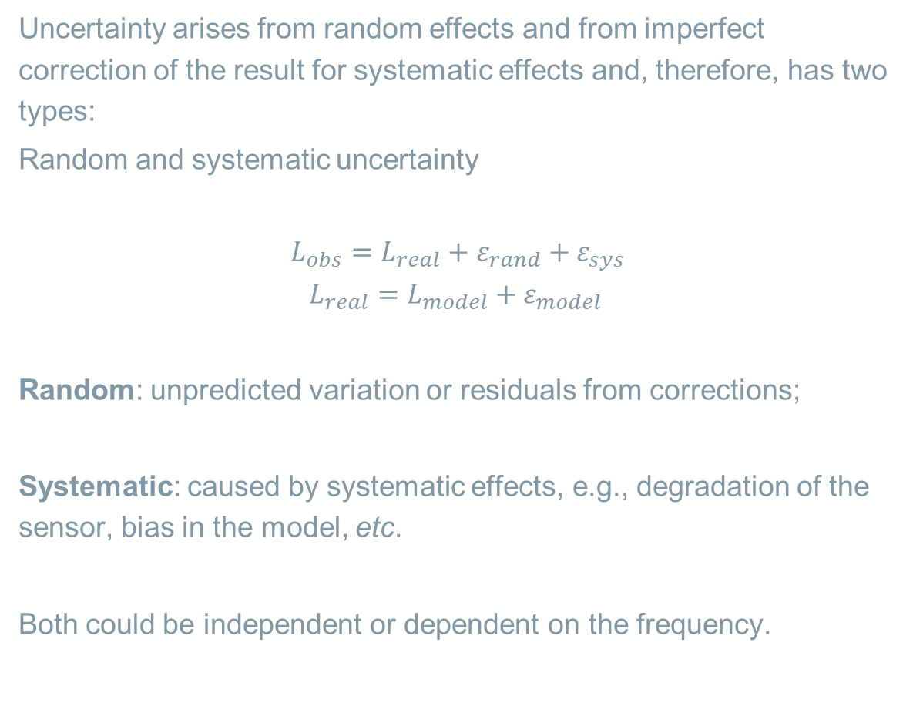
Types of uncertainty
Uncertainty arises from random effects and from imperfect correction of the result for systematic effects and, therefore, has two types:
Random and systematic uncertainty
$$L_{obs}=L_{real}+ε_{rand}+ε_{sys}$$
$$L_{real}=L_{model}+ε_{model }$$
Random: unpredicted variation or residuals from corrections;
Systematic: caused by systematic effects, e.g., degradation of the sensor, bias in the model, etc.
Both could be independent or dependent on the frequency.
"Fear Uncertainty Doubt" by psd is licensed with CC BY 2.0

Slide 9
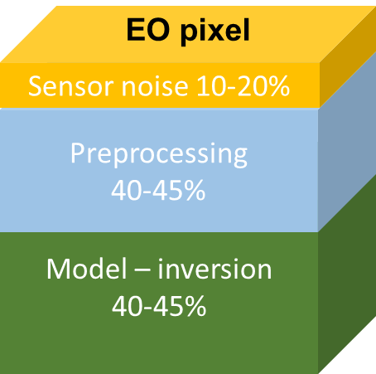
Sources of uncertainty
Every measurement is subject to some uncertainty.
A measurement result is only complete if it is accompanied by a statement of the uncertainty in the measurement.
For a satellite pixel we have uncertainty from model noise, pre-processing (e.g., atmospheric correction or roughness) and forward model formulation + parameterisation and the inversion scheme

Slide 10
Methods for estimating uncertainty
There are three methods to evaluate uncertainty: one is scalar (bias, RMSE) and the other two are based on estimating the probability distribution function (PDF) of measurements and/or the residuals.
Scalar
Using in-situ measurements matching satellite observation in time and location (matchups)
Type A
PDF is derived from an observed frequency distribution (e.g., high frequency in-situ measurement).
It should not be mixed with multi sensor observations!
Type B
PDF is assumed from known distribution (assumed): related to model-parametrisation setup, provides pixel-by pixel estimates, but these are somehow biased!!!

Slide 11
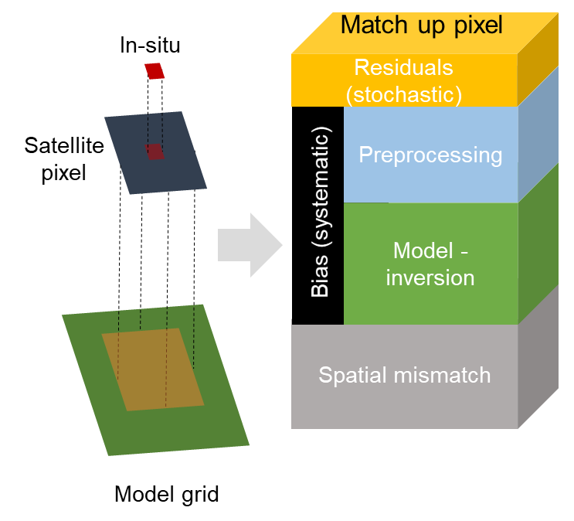
Scalar method using Match ups
Matchups are defined as the set of pairs of measured and observed values that have the same locations and times of sampling.
When comparing in-situ (point measurements) with a satellite pixel or model grid, an additional uncertainty component is added, namely the spatial mismatch.

Slide 12
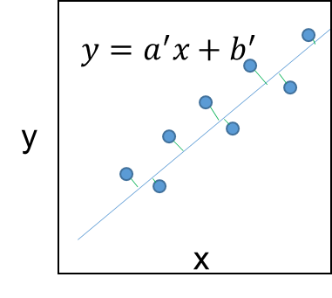
Validation with scalar method
The comparison of derived satellite values with in-situ measurement is carried out with type 2 regression (always linear regression): estimator sum of the squares of green lines is minimised.
Regression line pass through the centroid of the data 𝜇_𝑥,𝜇_𝑦 and the slope is adjusted to minimise the sum of the squares of the offsets between the line and the data.
The validation is carried out for the same physical variables on the x and y axes.
Validation produces uncertainty measures or (goodness-of- fit measures): slope and intercept, RMSE, R² and bias (mean of differences).

Slide 13
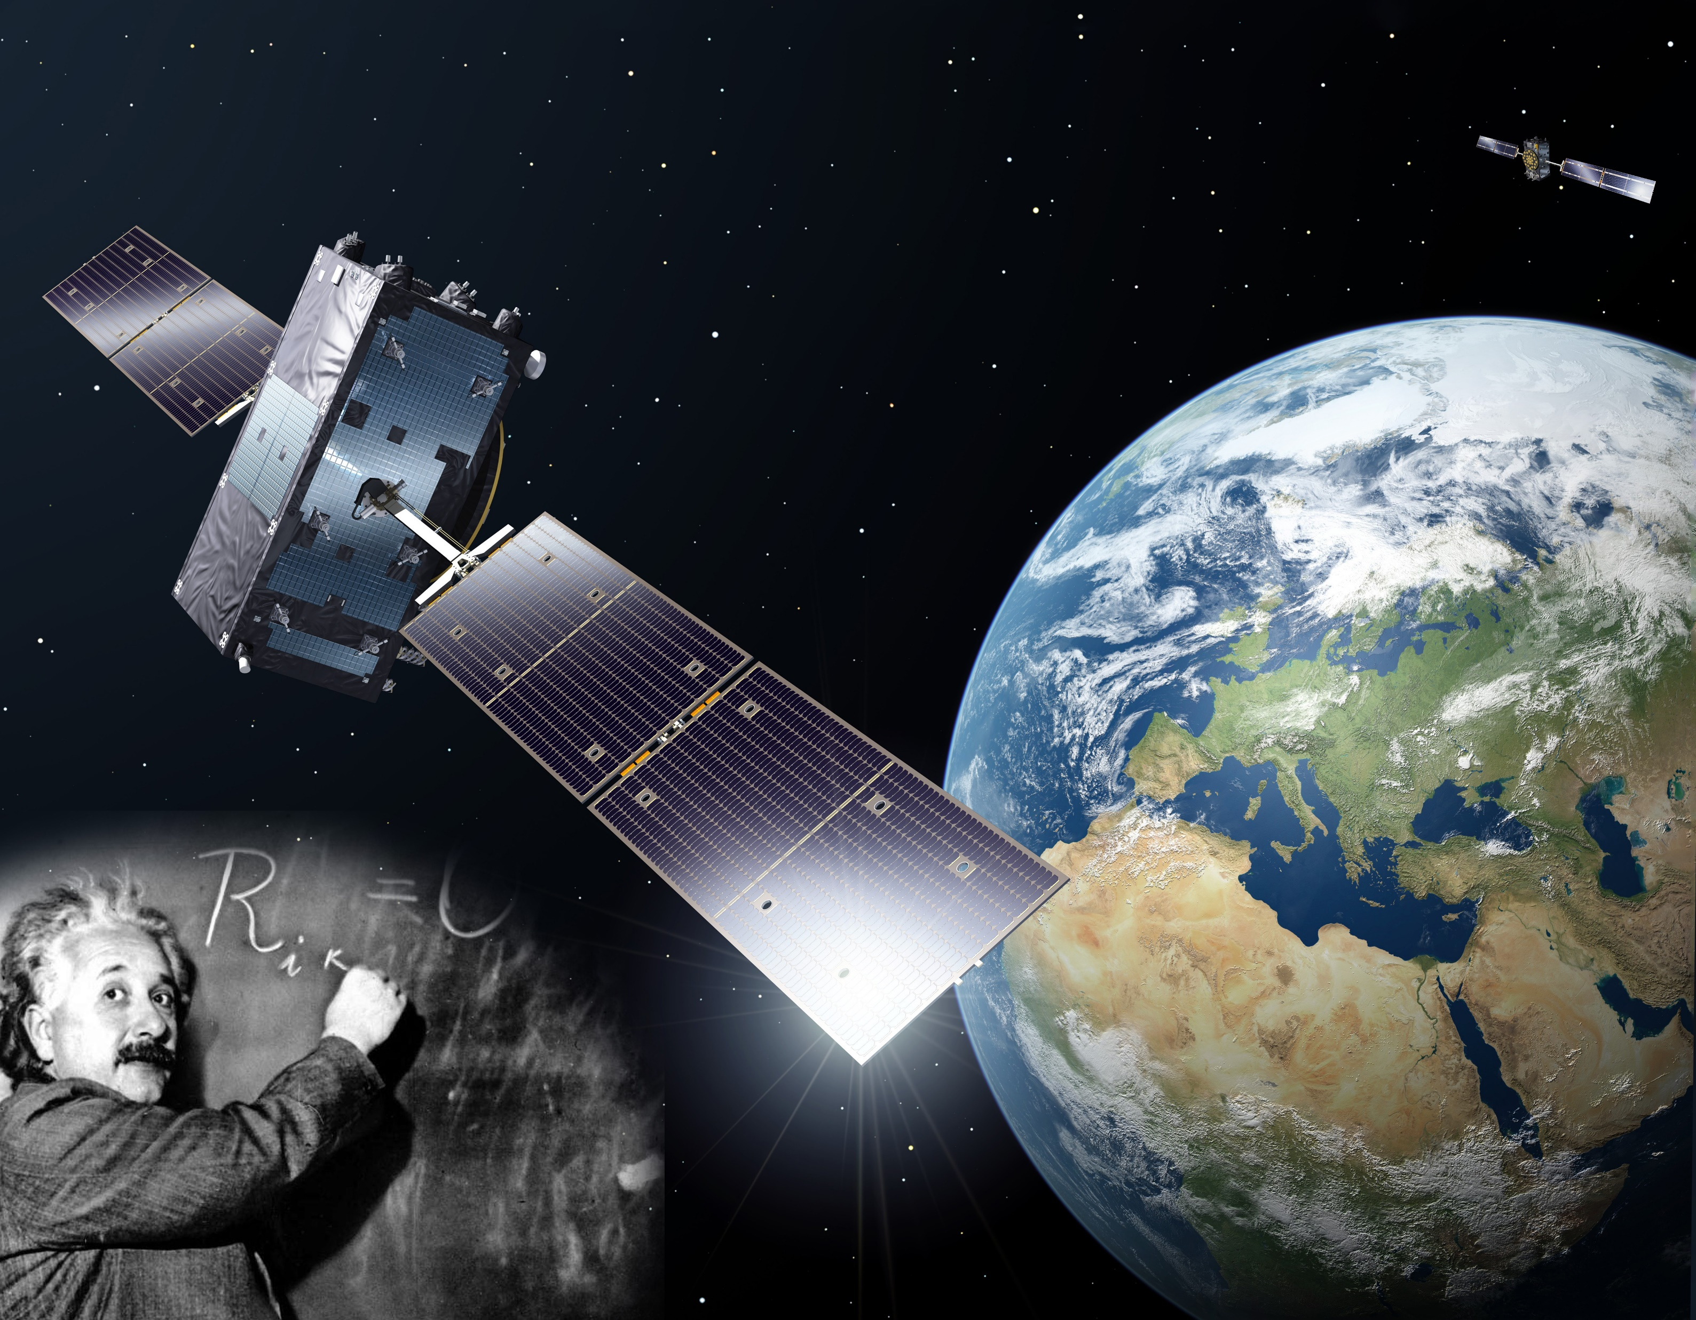
With reliable indicators we can produce good indices
https://www.esa.int/ESA_Multimedia/Images/2018/11/Galileos_measure_Einsteinian_time_dilation#.YRAyLNnDrBw.link

Slide 14
Meteorological drought indices
The Standardized Precipitation Index (SPI), McKee et al. (1993), is the most widely used meteorological drought index to monitor and follow drought conditions.
The World Meteorological Organization has recommended that the SPI be used by all National Meteorological and
Hydrological Services around the world to characterise meteorological droughts (World Meteorological Organization, 2012).
SPI measures precipitation anomalies at a given location, based on a comparison of observed total precipitation amounts for an accumulation period of interest (e.g., 1, 3, 12, 48 months), with the long-term historic rainfall record for that period.

Slide 15
Calculation of SPI
The historic record is fitted to a probability distribution (that reliably fits the long-term data), which is then transformed into a normal distribution using the inverse CDF method:
The fitted Gamma PDF is used to compute the Cumulative Distribution Function (CDF).
The CDF is transformed to standardised normal distribution.
You can do it in Excel/coding or use a tool, https://drought.unl.edu/droughtmonitoring/SPI/SPIProgram.aspx

Slide 16
Meaning of SPI values
SPI is calculated monthly but can be computed for accumulation periods of 3, 6 ,12, 24, 36 and 48 months.
When SPI is computed for 1 of 3 months, it can be used as an indicator for immediate impacts such as reduced soil moisture, snowpack, and flow in smaller creeks.
When SPI is computed for medium accumulation periods (3 to 12 months), it can be used as an indicator for reduced stream flow and reservoir storage.
When SPI is computed for longer accumulation periods (12 to 48 months), it can be used as an indicator for reduced reservoir and groundwater recharge.
Resource: factsheet_spi.pdf (europa.eu)

Slide 17
Interpretation of SPI values
Near normal condition
-2
-1,5
-1
0
1
1,5
2
Extremely dry
Sever dry
Mode-rate dry
Mild dry
Mild wet
Mode-rate
Sever wet
Extremely wet
68%
9%
9%
4%
4%
2%
2%
-2
-1,5
-1
0
1
1,5
2
After WMO 2012

Slide 18
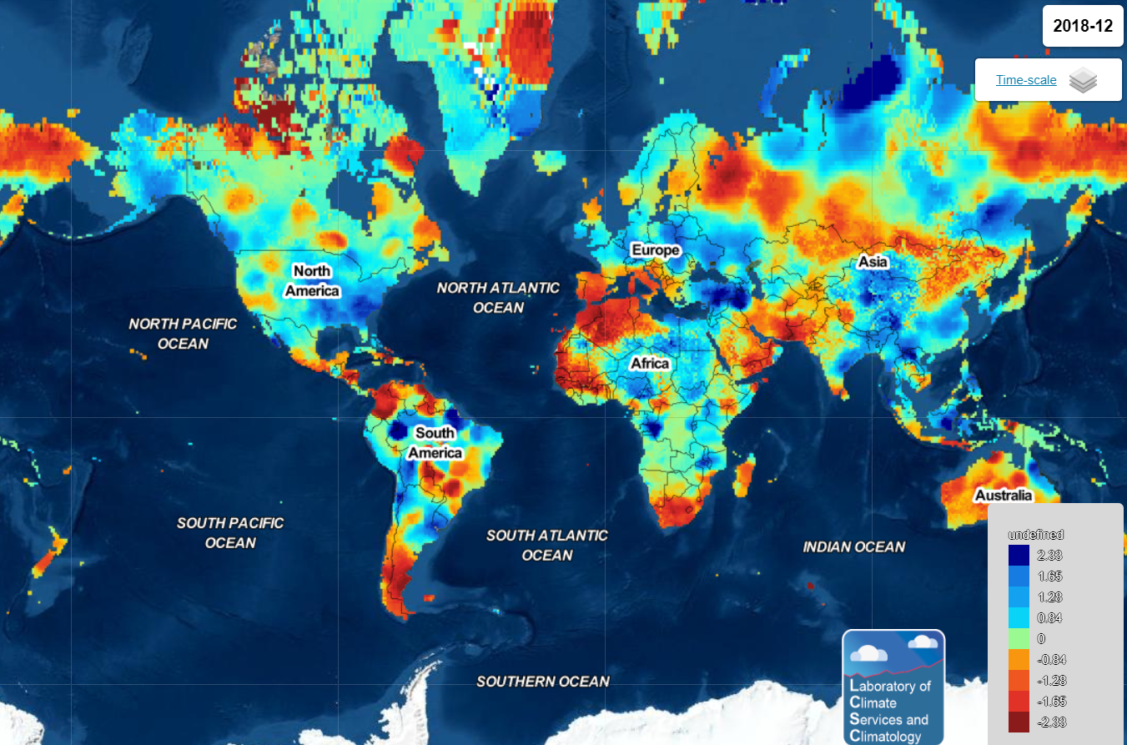
Standardized precipitation and Evaporation Index
SPEI - The computation of SPEI involves use of precipitation and crop reference evapotranspiration (ETref) data.
The methods for calculating evapotranspiration from meteorological data require various climatological and physical parameters. Some of the data are measured directly in weather stations.
Other parameters are related to commonly measured data and can be derived with the help of a direct or empirical relationship. (http://www.fao.org)
https://spei.csic.es/spei_database/#map_name=spei01#map_position=1415

Slide 19
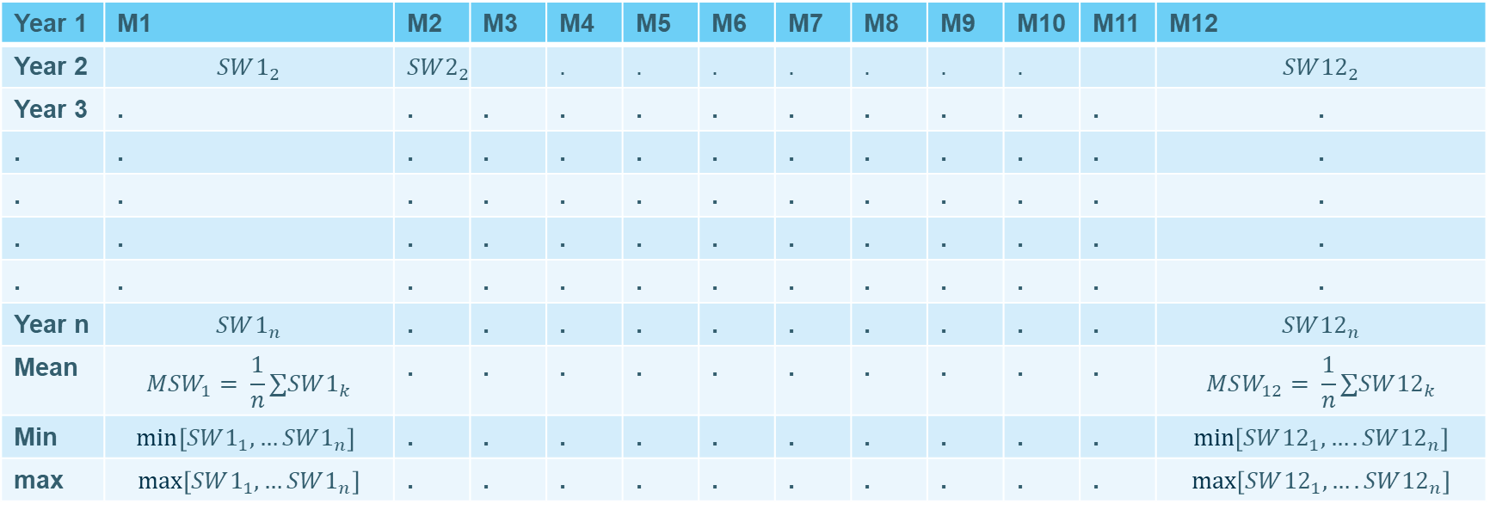
Agriculture drought indices
Soil Moisture can be used as a drought index to identify agriculture drought.
The climatology mean, maximum and minimum are first calculated.
Year 1 | M1 | M2 | M3 | M4 | M5 | M6 | M7 | M8 | M9 | M10 | M11 | M12
Year 2 | $$SW1_{2}$$ | $$SW2_{2}$$ |  | . | . | . | . | . | . | . |  | $$SW{12}_{2}$$
Year 3 | . | . | . | . | . | . | . | . | . | . | . | .
. | . | . | . | . | . | . | . | . | . | . | . | .
. | . | . | . | . | . | . | . | . | . | . | . | .
. | . | . | . | . | . | . | . | . | . | . | . | .
. | . | . | . | . | . | . | . | . | . | . | . | .
Year n | $$SW1_{n}$$ | . | . | . | . | . | . | . | . | . | . | $$SW{12}_{n}$$
Mean | $$MSW_{1}= \frac{1}{n}∑SW1_{k}$$ | . | . | . | . | . | . | . | . | . | . | $$MSW_{12}= \frac{1}{n}∑SW{12}_{k}$$
Min | $$min\left[SW1_{1},…SW1_{n}\right]$$ | . | . | . | . | . | . | . | . | . | . | $$min\left[SW{12}_{1},….SW{12}_{n}\right]$$
max | $$max\left[SW1_{1},…SW1_{n}\right]$$ | . | . | . | . | . | . | . | . | . | . | $$max\left[SW{12}_{1},….SW{12}_{n}\right]$$

Slide 20



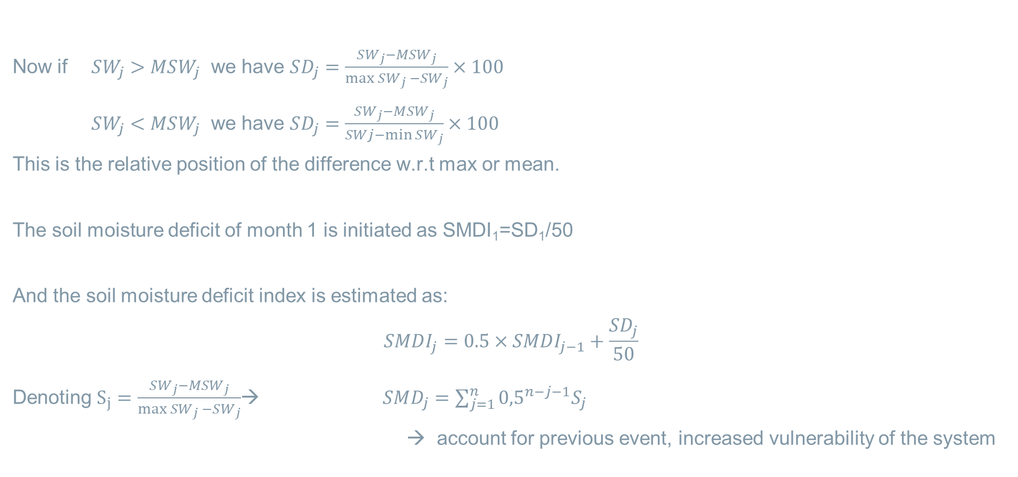



Soil moisture deficit index
$$\max{SW_{j}}$$
Now if $SW_{j}>MSW_{j}$ we have $SD_{j}=\frac{SW_{j}−MSW_{j}}{\max{SW_{j} −}SW_{j}}×100$
$SW_{j}<MSW_{j}$ we have $SD_{j}=\frac{SW_{j}−MSW_{j}}{SWj−\min{SW_{j}}}×100$
This is the relative position of the difference w.r.t max or mean.
The soil moisture deficit of month 1 is initiated as SMDI₁=SD₁/50
And the soil moisture deficit index is estimated as:
$$SMDI_{j}=0.5×SMDI_{j−1}+\frac{SD_{j}}{50}$$
Denoting $S_{j}=\frac{SW_{j}−MSW_{j}}{\max{SW_{j} −}SW_{j}}$→ $SMD_{j}=\sum_{j=1}^{n}{{0,5}^{n−j−1}S_{j}}$
→ account for previous event, increased vulnerability of the system
$$SW_{j}$$
$$MSW_{j}$$
$$SW_{j}$$
$$\min{SW_{j}}$$
$$\frac{1}{2^{n−j−1}}$$
.
.
1/8
1/4
1/2
1
2

Slide 21
Interpretation of SMDI values
Similar to SPI, but the assumption of normally distributed values is not valid and should be checked first
-4
-2
-1,5
-1
0
1
1,5
2
4
Extremely dry
Sever dry
Mode-rate dry
Mild dry
Mild wet
Mode-rate
Sever wet
Extremely wet

Slide 22
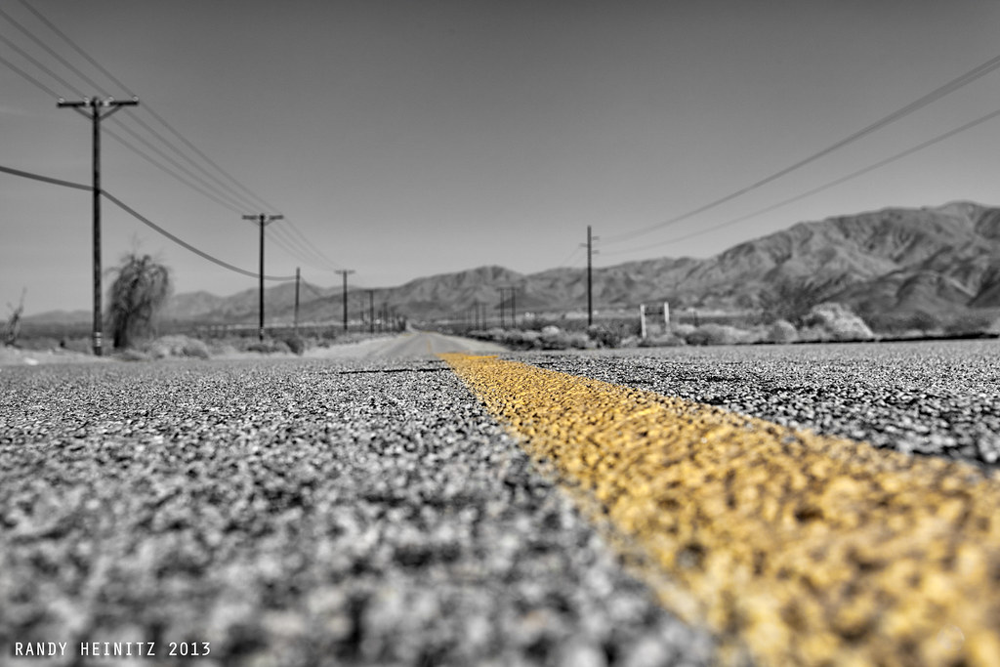
Closure
In this course we have learnt about drought and covered a few metrological and agricultural indicators and indices.
We touched upon the concepts of satellite derivation of drought indicators and indices, with a focus on soil moisture.
We learnt how satellite derived indicators are validated by using field data.
We used CCI data and tools to analyse satellite-derived products of soil moisture and to quantify the agricultural drought of 2018 in the Netherlands.
We have analysed the frequency of occurrence of drought/flood indicators and indices, and predicted their return period.
"Never Ending Dillon Road" by Randy Heinitz is licensed with CC BY 2.0

Slide 23
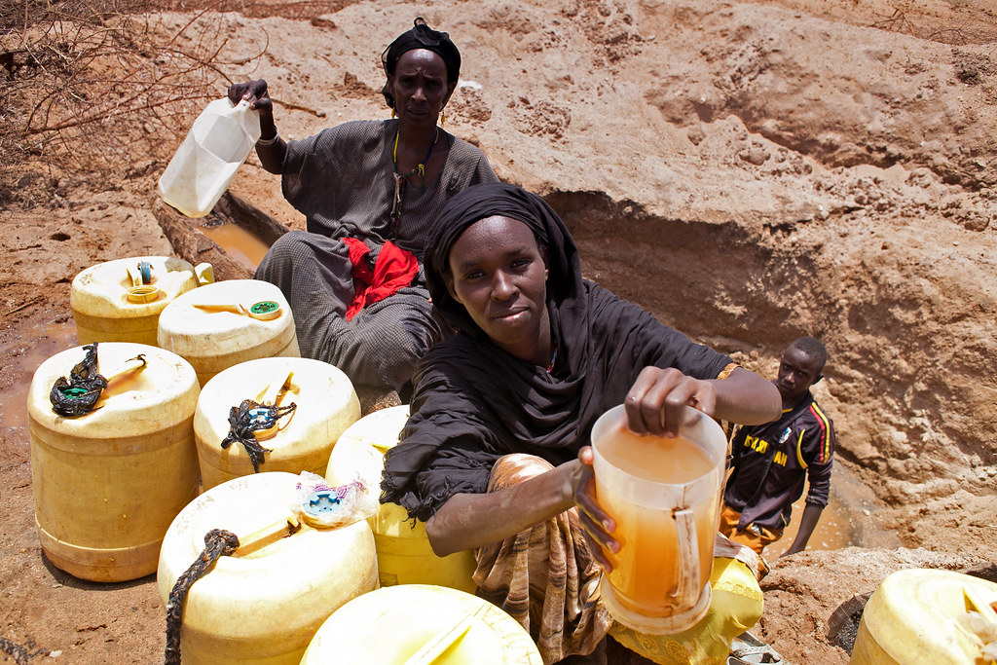
Looking for water never ends!
So by this, we finished the lecturing part of this course, let us get back to work looking for water!
"9-Drought in Kenya's Ewaso Ngiro river basin" by Climate Centre is licensed with CC BY-NC 2.0.

Slide 24
ESA COMMUNICATION
corporatebranding@esa.int

Slide 25
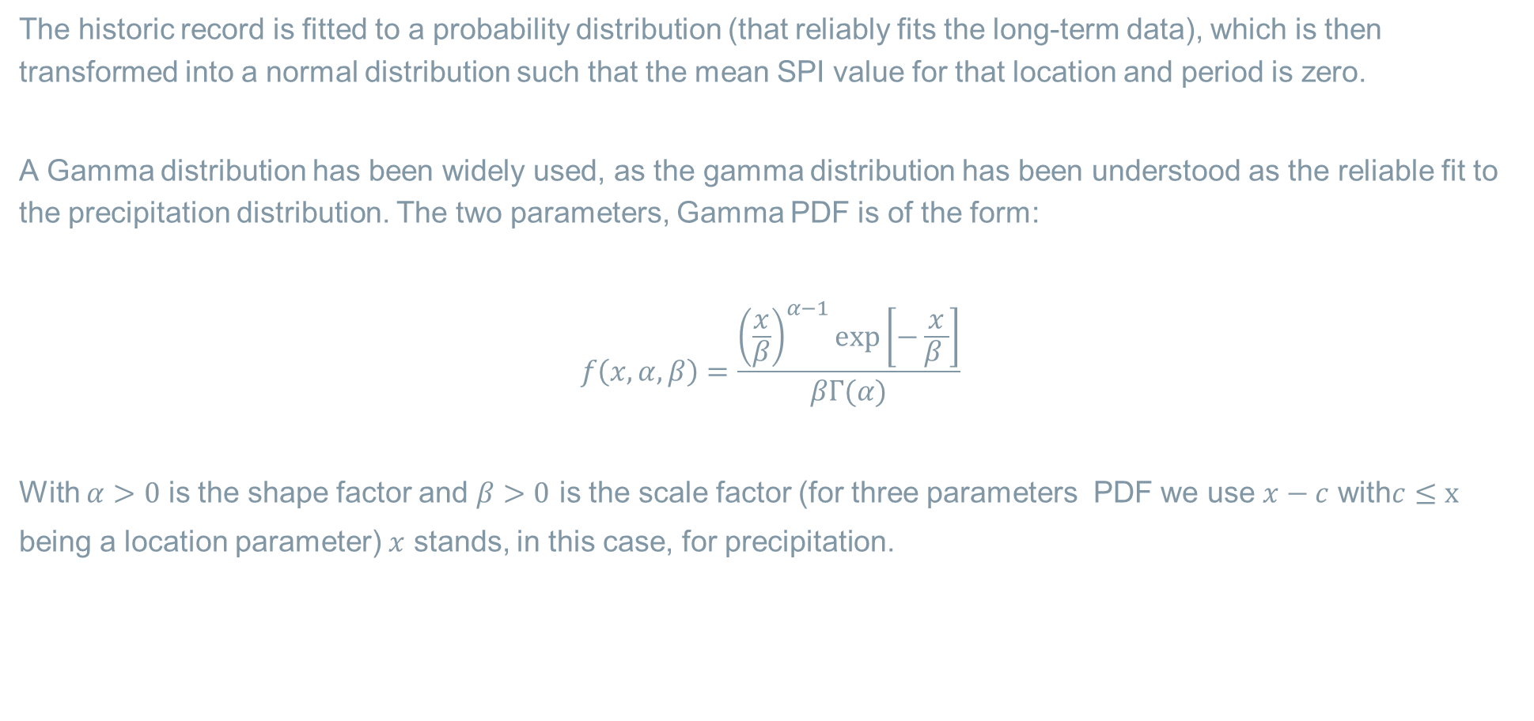
Calculate SPI yourself!
The historic record is fitted to a probability distribution (that reliably fits the long-term data), which is then transformed into a normal distribution such that the mean SPI value for that location and period is zero.
A Gamma distribution has been widely used, as the gamma distribution has been understood as the reliable fit to the precipitation distribution. The two parameters, Gamma PDF is of the form:
$$f\left(x,α, β\right)=\frac{{\left(\frac{x}{β}\right)}^{α−1}exp\left[−\frac{x}{β }\right]}{βΓ(α)}$$
With $α>0$ is the shape factor and $β>0$ is the scale factor (for three parameters PDF we use $x−c$ with$c≤x$
being a location parameter) $x$ stands, in this case, for precipitation.

Slide 26
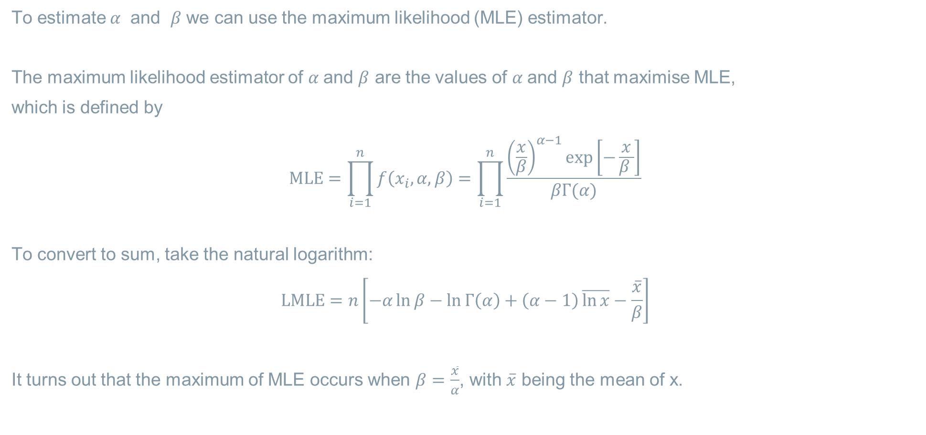
Calculate SPI yourself!
To estimate $α$ and $β$ we can use the maximum likelihood (MLE) estimator.
The maximum likelihood estimator of $α$and $β$ are the values of $α$and $β$ that maximise MLE,
which is defined by
$$MLE=\prod_{i=1}^{n}{f\left(x_{i},α, β\right)=\prod_{i=1}^{n}{\frac{{\left(\frac{x}{β}\right)}^{α−1}exp\left[−\frac{x}{β }\right]}{βΓ(α)}}}$$
To convert to sum, take the natural logarithm:
$$\operatorname{LMLE}{=n\left[−α\ln{β}−\ln{Γ\left(α\right)+\left(α−1\right)}\overline{\ln{x}}−\frac{\overline{x}}{β}\right]}$$
It turns out that the maximum of MLE occurs when $β=\frac{\overline{x}}{α}$, with $\overline{x}$ being the mean of x.

Slide 27

Calculate SPI yourself!
Substitute $β=\frac{\overline{x}}{α}$, in
$$\operatorname{LMLE}{=n\left[−α\ln{β}−\ln{Γ\left(α\right)+\left(α−1\right)}\overline{\ln{x}}−\frac{\overline{x}}{β}\right]}$$
and solve for $β$ or use the iteration.
Convert the Gamma PDF to CDF.

